Slide 1
Multi-omics Data In The Identification Of Kidney Cancer Subgroups
Supervisor
Dr. Pratheeba J.
By
2018/E/073: Mr. Maduranga W.P.N.
2018/E/102: Mr. Rodrigo S.M.
Co-Supervisor
Dr. Thuseethan S.
EC6070 - COMPUTER ENGINEERING RESEARCH PROJECT

Slide 2
Introduction
Our research is related to the medical field and the goal is to classify the Kidney cancer patients into their clinical subgroups with a better accuracy.
To accomplish that task, we have choose 3 main components known as,
Major subtypes of Kidney cancer
Multi Omics data
Machine Learning
Significance of the Research
Kidney cancer is a common cancer variant at present.
People who are elder than 60 are the mostly affected group and about 79,000 cases identified annually. Usually 14,000 deaths recorded among them.
Fortunately, there are considerable possibilities of get cured, if it can be detected in the early stages.
2
Notes:
Clear cell
Papillary
Chromophobe

Slide 3
Literature Review
Current technologies allow us to measure various molecular data, which is also called as omic data.
Generally, single omic data is selected and used in the cancer related studies. Some single omic data used in literature review are,
miRNA Genome Data [1]
autophagy-related proteins [6]
transcriptomic data [2]
Genomics [3]
Methylation [3]
Some researchers used Multi-omic data in cancer related studies [4,5, 8-10].
3
Notes:
Multi omic - a combination of a single omic

Slide 4
Literature Review
There are various types of kidney cancer subtypes. Subtypes identified in literature are,
Kidney Renal Clear Cell Carcinoma (ccRCC) [1-10]
Kidney Renal Papillary Cell Carcinoma (pRCC) [1-4,6-10]
Kidney Chromophobe (ccRCC) [1-4,6-10]
Rhabdoid Tumor [1]
High-Risk Wilms Tumor [1]
Clear Cell Sarcoma [1]
4
Notes:
There are more than 200 types of cancers. But here we focusing kidney cancer and its subtype classification.

Slide 5
Literature Review
Machine learning methods are mostly used in the prediction of kidney cancer subgroups.
Some of the machine learning methods identified from the literature are,
Long Short Term Memory (LSTM) [1]
Neighborhood Component Analysis (NCA) [1]
K-Nearest Neighbor (KNN) [6]
support vector machine (SVM) [4]
random forest (RF) [2,4]
multi layer perceptron (MLP) [4]
Bayesian neural network (BNN) [4]
XOmiVAE (Deep Learning) [3]
5

Slide 6
State of Art
He, Z., Liu, H., Moch, H. et al. Machine learning with autophagy-related proteins for discriminating renal cell carcinoma subtypes. Sci Rep 10, 720 (2020). https://doi.org/10.1038/s41598-020-57670-y
What they have done? |  | Methods used |  | Gap
They tested the possibility of using autophagy proteins (ATGs), for classification of renal cell carcinomas (RCC). |  | Analyzed data using different data cleaning and a machine learning technique (KNN) to classify the subtypes of RCCs. |  | Single omic data No comparison between machine learning methods Prediction accuracy very low (especially for biological problem) with protein data.
6
Notes:
This is the most recent and very related article.
Optimal K value determined by a 4-fold cross validation
237 RCCs from untreated patients and 18 normal kidney tissues

Slide 7
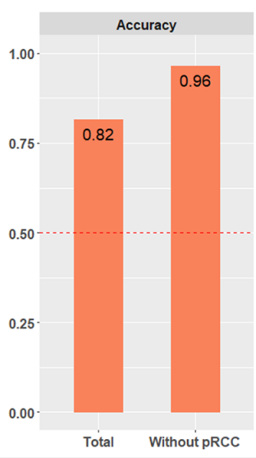
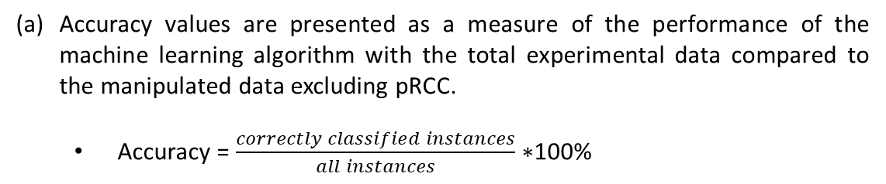
State of Art
Accuracy of the model
Protein | Area Under Curve (AUC) values (%)
Protein type | crRCC | ccRCC | pRCC
ATG1 | 68.3 | 92.0 | 85.6
ATG16L1 | 74.4 | 60.1 | 69.2
ATG5 | 91.7 | 90.2 | 69.3
LC3B | 53.3 | 98.6 | 80.1
p62 | 85.6 | 50.8 | 55.2
(a)
Accuracy values are presented as a measure of the performance of the machine learning algorithm with the total experimental data compared to the manipulated data excluding pRCC.
Accuracy = $\frac{correctly classified instances}{all instances}∗$100%
7
Notes:
Accuracy of cancer related studies is more important to up lift the treatment scenarios for patients.

Slide 8
Data of the study
The Cancer Genome Atlas (TCGA) Data Repository
For our study, we got following datasets:
DNA methylation (Methylation450k)
gene expression (RNAseq)
protein expression (reverse phase protein array (RPPA))
miRNA (IlluminaHiseq)
8
Notes:
TCGA – a data repository which collected, characterized, and analyzed cancer samples from over 11,000 patients over 15 year period.
Latest techniques that used for analysis

Slide 9
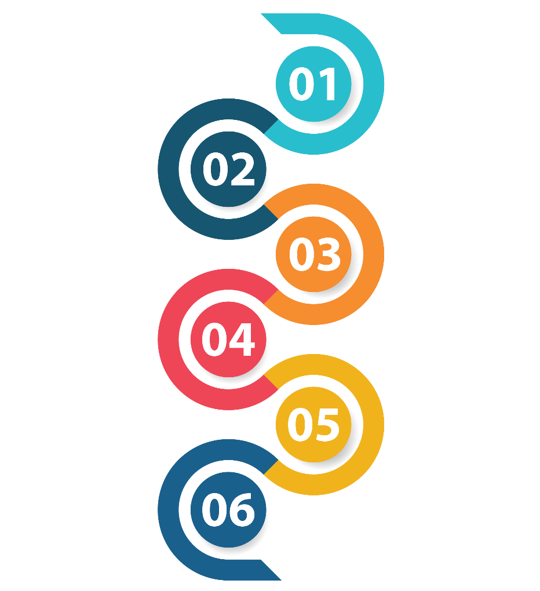
Methodology
Dataset Selection
Data Preprocessing
Feature Selection
Prediction Methods
Comparing the Performance
Finalize the model
9
Notes:
Data preprocessing in Machine Learning refers to the technique of preparing (cleaning and organizing) the raw data to make it suitable for a building and training Machine Learning models.

Slide 10
Feature Selection
Forward feature selection
This is an iterative process, which begins with an empty set of features. After each iteration, it keeps adding on a feature and evaluates the performance to check whether it is improving the performance or not.
Backward feature elimination
Backward elimination is also an iterative approach, but it is the opposite of forward feature selection. This technique begins the process by considering all the features and removes the least significant features one by one.
Pearson correlation
The Pearson correlation measures the strength of the linear relationship between two variables. It has a value between -1 to 1, with a value of -1 meaning a total negative linear correlation, 0 being no correlation, and + 1 meaning a total positive correlation.
10
Notes:
Feature selection is to select some valuable features among many features.
Forward- Choose the significant features one by one
Backward- Removes the least significant features one by one
Pearson- Define the strength of a feature on relationship

Slide 11
Prediction Methods
Logistic Regression
Logistic regression is a calculation used to predict a binary outcome: either something happens, or does not. This can be exhibited as Yes/No, Pass/Fail, Alive/Dead, etc.
Support Vector Machines
A support vector machine (SVM) uses algorithms to train and classify data within degrees of polarity, taking it to a degree beyond X/Y prediction.
K-Nearest Neighbors
K-nearest neighbors (k-NN) is a pattern recognition algorithm that uses training datasets to find the k closest relatives in future examples.
11
Notes:
Linear Models
Non-linear Models
Classification algorithms
The Classification algorithm is a Supervised Learning technique that is used to identify the category of new observations on the basis of training data. In classification, a program learns from the given dataset or observations and then classifies the new observation into a number of classes or groups.

Slide 12
Progress to date
Annotated Bibliography
We referred research articles related to our topic and have written the annotated bibliographies for each articles.
Data collection
We had downloaded some datasets from The Cancer Genome Atlas (TCGA) Data Repository. We considered the 4 omics approaches which we focused in our project when choosing datasets.
Proposal writing
We have started to work on the main sections which need for the proposal. Now we are focusing on collecting information.
12

Slide 13

Workplan
 | ^{Semester 06} |  |  |  |  |  | ^{Semester 07} |  |  |  | ^{Semester 08}
 | w01 | w06 | w09 | w10 | w18 | w20 | w01 | w03 | w09 | w16 | w01 | w03 | w08
Literature review
Bibliography writing
Data collection
Research Proposal writing
Data preparation
Finalize the model
Model implementation
Research Report writing
Research paper writing
13

Slide 14
References
Muhamed Ali, Ali, Hanqi Zhuang, Ali Ibrahim, Oneeb Rehman, Michelle Huang, and Andrew Wu. 2018. "A Machine Learning Approach for the Classification of Kidney Cancer Subtypes Using miRNA Genome Data" Applied Sciences 8, no. 12: 2422. https://doi.org/10.3390/app8122422
Marquardt, André et al. “Subgroup-Independent Mapping of Renal Cell Carcinoma-Machine Learning Reveals Prognostic Mitochondrial Gene Signature Beyond Histopathologic Boundaries.” Frontiers in oncology vol. 11 621278. 15 Mar. 2021, doi:10.3389/fonc.2021.621278
Eloise Withnell, Xiaoyu Zhang, Kai Sun, Yike Guo, XOmiVAE: an interpretable deep learning model for cancer classification using high-dimensional omics data, Briefings in Bioinformatics, Volume 22, Issue 6, November 2021, bbab315, https://doi.org/10.1093/bib/bbab315
Lovino, M., Bontempo, G., Cirrincione, G., Ficarra, E. (2020). “Multi-omics Classification on Kidney Samples Exploiting Uncertainty-Aware Models”. In: Huang, DS., Jo, KH. (eds) Intelligent Computing Theories and Application. ICIC 2020. Lecture Notes in Computer Science (), vol 12464. Springer, Cham. https://doi.org/10.1007/978-3-030-60802-6_4
Hu F, Zeng W, Liu X. A Gene Signature of Survival Prediction for Kidney Renal Cell Carcinoma by Multi-Omic Data Analysis. International Journal of Molecular Sciences. 2019; 20(22):5720. https://doi.org/10.3390/ijms20225720
14

Slide 15
References
He, Z., Liu, H., Moch, H. et al. Machine learning with autophagy-related proteins for discriminating renal cell carcinoma subtypes. Sci Rep 10, 720 (2020). https://doi.org/10.1038/s41598-020-57670-y
Eliana Marostica, Rebecca Barber, Thomas Denize, Isaac S. Kohane, Sabina Signoretti, Jeffrey A. Golden, Kun-Hsing Yu; Development of a Histopathology Informatics Pipeline for Classification and Prediction of Clinical Outcomes in Subtypes of Renal Cell Carcinoma. Clin Cancer Res 15 May 2021; 27 (10): 2868–2878. https://doi.org/10.1158/1078-0432.CCR-20-4119
Wu J, Jin S, Gu W, Wan F, Zhang H, Shi G, Qu Y and Ye D (2019) Construction and Validation of a 9-Gene Signature for Predicting Prognosis in Stage III Clear Cell Renal Cell Carcinoma. Front. Oncol. 9:152. doi: 10.3389/fonc.2019.00152
Terrematte, P.; Andrade, D.S.; Justino, J.; Stransky, B.; de Araújo, D.S.A.; Dória Neto, A.D. A Novel Machine Learning 13-Gene Signature: Improving Risk Analysis and Survival Prediction for Clear Cell Renal Cell Carcinoma Patients. Cancers 2022, 14, 2111. https://doi.org/10.3390/cancers14092111
Huang, Jennifer J, and James J Hsieh. “The Pan-Omics Landscape of Renal Cell Carcinoma and Its Implication on Future Clinical Practice.” Kidney cancer (Clifton, Va.) vol. 4,3 121-129. 16 Sep. 2020, doi:10.3233/KCA-200085
15

Slide 16
References
https://www.javatpoint.com/feature-selection-techniques-in-machine-learning
https://www.javatpoint.com/classification-algorithm-in-machine-learning
16

Slide 17
Thank You!

